Slide 1
Engaging Pro Bono and Skilled Volunteers Jennifer Bennett, Senior Manager, Education & Training
Jennifer R. Bennett, CVA
Director, Education & Training
VolunteerMatch
jbennett@volunteermatch.org
@JenBennettCVA

Slide 2
Nonprofits Have the Need

Slide 3
Volunteers Have the Skills
VolunteerMatch Volunteers
Among my career skills
49%
36%
33%
30%
35%
24%
29%
28%
Have done as volunteer
28%
18%
16%
16%
22%
12%
18%
32%
Gap
-21
-18
-17
-14
-13
-12
-11
+4
Computers/hardware/software
Operations/project management
HR/recruitment and training
Strategic planning
Marketing/communications
Information technology
Program development
Fundraising/development
Source: Hart Consulting and VolunteerMatch Survey - 2010

Slide 4
Impactful…
Pro Bono volunteers can
Bring specific skills and expertise
Provide singular focus on projects
Expand the capacity of paid staff

Slide 5
But not easy…
There can be pitfalls
Wrong volunteer for the role/library
Unreasonable scope
Volunteers improperly screened – paid staff improperly prepared
Previous bad experiences can influence staff attitudes and enthusiasm

Slide 6
Integrating Pro Bono Volunteers
Keys for building buy-in
Communicate to others – paid and volunteer staff
Agree on skills and expertise, and screening criteria
Manage scope with position descriptions and deliverables
Clear reporting structure and decision-making responsibilities

Slide 7
Communicate to Build Buy-In
Identify Stakeholders
Board, Exec. Management, Program Managers, Paid Staff, Volunteer Staff
Assess where each stakeholder is on the engagement continuum
Work with Champions - Share persuasive information with Information Seekers, Opponents

Slide 8
Involve Others in the Process
Engage supervisors or program managers in the process to build buy-in
What does a volunteer need to know, do or be to be the right volunteer?
Clear and comprehensive position descriptions
Responsibilities, decision making continuum
Interviews and screening process
Screen for culture and fit not just for skills and traits (and not just “people like me”)

Slide 9
Design Successful Projects
Successful projects include:
Measurable deliverables or outcomes
Accountabilities and responsibilities
Timeline with evaluation
Manage scope to create more successful skills-based opportunities for Pro Bono volunteers

Slide 10
Resources for Designing Projects
Taproot Foundation Resources
https://taprootfoundation.org/resources/common-pro-bono-projects-catalog/
Common Impact Skills-Based Volunteering Tool Kit
https://commonimpact.org/pdf/SBVToolkit.pdf

Slide 11
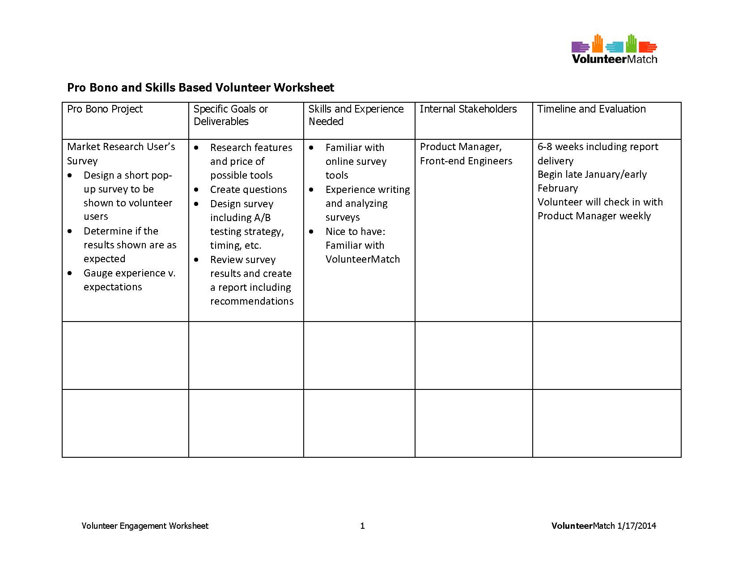
Scope a Project

Slide 12
Key Program Foundations & Documents
Ensure everyone is on the same page!
Position description
Agreement letter that includes a timeline
NDA or confidentiality agreement
Policies and procedures manual – as appropriate
Intellectual property, conflict resolution, termination, etc.

Slide 13
Finding the Right Volunteer
Recruit through appropriate channels
VolunteerMatch, corporate partners, professional associations
Explore existing volunteer’s skills
Tap into your network – donors, members, supporters
Screen for skills, experience, and cultural fit
Orient to work and library

Slide 14
Support the Volunteer/Paid Staff Relationship
Supervisors may not have much management experience
Start with the volunteer management basics
Share resources – blogs, webinars, etc.
Facilitate the relationship
Let go without checking out
Assist in managing expectations
Remove barriers, help solve challenges
Design meaningful recognition

Slide 15
Evaluating Pro Bono Volunteer Engagement
There will be challenges
Implement regular check-ins, build on them
Share challenges and solutions across supervisors and projects
Solicit feedback from supervisors and volunteers
Share with your Information Seekers – great information for your communication channels!

Slide 16
Putting a Plan in Place
Identify stakeholders and strategic needs
Invest in foundation documents and processes
Create clear and manageable scope
Conduct appropriate screening and orientation
Develop and build-on evaluation points
Share impact and create meaningful recognition

Slide 17
Resources
Learning Center
Find upcoming webinar dates, how-to videos and more
http://learn.volunteermatch.org
VolunteerMatch Blog
Visit Engaging Volunteers, our nonprofit blog: blogs.volunteermatch.org/engagingvolunteers/
Library Get Involved Resources
Sample position descriptions, handbooks, recorded trainings, recruitment resources
http://www.getinvolvedca.org/
Related Webinar Topics:
Walking the Walk: Engage Volunteers in your Volunteer Engagement Program
Creating a Comprehensive and Engaging Volunteer Training Program
Managing Difficult Volunteer Transitions

Slide 18
Thanks for attending!
Join us online:
Like us on Facebook: www.Facebook.com/VolunteerMatch
Follow us on Twitter: @VolunteerMatch
For any questions contact:
Jennifer Bennett
@JenBennettCVA
jbennett@volunteermatch.org

