Slide 1
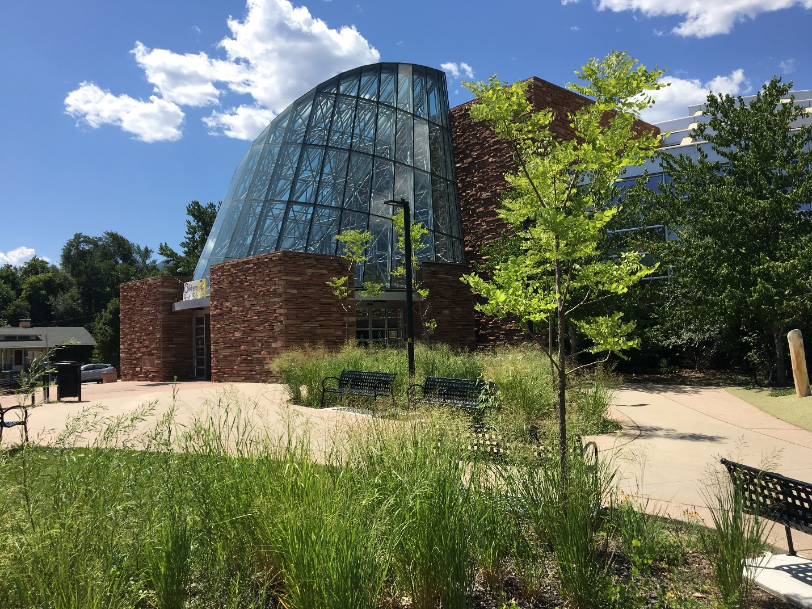
Book Drop Helper and Sorter Training

Slide 2
Thank you for volunteering with us!
Your assistance is invaluable.
NOTE:
If you have not already taken the COVID19 Safety Volunteer Training, please stop now and take this training first.

Slide 3
Core Components of the Book Drop Sorter Volunteer Role:
Collect book drop bins at the Main Library, one located at the Arapahoe entrance and one at the Canyon entrance
Bring the full bins of materials into the library quarantine rooms
Remove materials from the bins and sort them into the correct room

Slide 4
As mentioned in the position description when you applied:
You will be pulling and pushing bins full of library materials, which can be up to 40 pounds, from the book drop bins to designated rooms in the library.
The bins are on wheels.

Slide 5
Health and Safety Protocol
for this Volunteer Role
Before entering the building, you will be required to check in at the temperature self-check station.
You will take your temperature and register the time, date, and your name in the log.
Staff and volunteers are required to wear masks and gloves in the building.
Always observe safe social distancing measures. Stay six feet from staff and other volunteers.
Hand sanitizer and disinfecting wipes are located at each workstation.
Use waste receptacles at active workstations (near entry/exit, family restrooms).

Slide 6
Safety Training Resources
Training on proper fit of cloth mask https://covid19.colorado.gov/mask-guidance
Training on the proper removal of gloves https://covid19.colorado.gov/mask-guidance
Training on cleaning and disinfecting surfaces https://covid19.colorado.gov/cleaning-guidance

Slide 7
Next you will be asked to view the video to learn these aspects of your role:
Checking your temperature and signing in
Entering the library
Picking up your mask and gloves (available from the library if needed)
Getting the book drop key, volunteer badge, and info sheet
Opening, emptying, and closing the Arapahoe book drop
Identifying Flatirons Library Consortium (FLC) materials
NOTE: you may want to TURN UP your computer volume because the video has low volume.

Slide 8
Video covering entering building to sorting FLC items

Slide 9
Materials from the Flatirons Library Consortium (FLC) should be put in the Boulder Creek Room (the larger room)
Six libraries comprise the FLC:
Boulder
Broomfield
Lafayette
Longmont
Louisville
Loveland
A printed list of these libraries will be posted in the Boulder Creek Room.
Materials from other library (Prospector materials) will be quarantined in a separate room. Explained in the next video.

Slide 10
Next you will be asked to view the video to learn these aspects of your role:
Picking up the bin near the Canyon entrance
Opening, emptying, and closing the Canyon book drop
Re-entering into the Canyon library entrance
Crossing the library with the bin
Sorting books; includes clarity on books from Prospector materials (not FLC)
Returning the keys and volunteer badge

Slide 11
Video of picking up the Canyon bin and bringing it back to the Prospector sorting room

Slide 12
As mentioned in the video…
When you bring the bin back from the Canyon side, you will need to push it up a ramp and down a ramp. Please be careful because the bin can gather momentum going down the ramp.
If you can’t safely bring it down the ramp, please inform a staff member who can help you.

Slide 13
Addendum to the videos:
The book drops CANNOT be left without
a black bin inside of them.
Please take an empty bin to each book drop location when you go to retrieve the full bin.
Given that you need to bring an empty bin with you when you go to the Canyon side, walk through the library and out the Canyon side door to retrieve the bin. Be sure no one enters the building. (same route shown in the video)
Empty black bins can be found in front of, or inside, the Boulder Creek Room. This is the room where you will leave the FLC books.

Slide 14
If approached by the public outside:
Recommended talking points:
I am a volunteer helping empty the bins. Please maintain your distance.
The library is not open for visitors. You can get the most up-to-date information on its website.
You’re interested in computer access? I know the library is working on a plan. Please watch the Library's website for more information.
Please read the information on the flyer you pick up at the PPE table before getting started.

Slide 15
A few final items:
Please use family restrooms in the children’s area ONLY- all other restrooms are closed.
Areas of building that are activated in phase 1: limit your activity to these areas except when working with the Canyon bin:
Arapahoe entry & conoid
Accounts desk and accounts workroom
Hold shelves
Quarantine rooms: Boulder Creek and Eldorado
Walking elsewhere in the library is only permitted to bring over and pick up a Canyon book drop bin. Do not wander in the library to avoid requiring cleaning in additional spaces.

Slide 16
Parking at the Library:
Every day: Street parking is free with no time constraints if you wish to avoid registering your car and paying to park in a library lot.
Monday – Friday:
If you wish to park in a library lot, you must register your car at the parking lot kiosk
Free parking is available for 90 minutes and the remainder of your shift time (approximately 35 minutes) must be paid.
Tokens to pay for the 35 minutes of parking that is not free can be found on volunteer table where you pick up your volunteer badge. They are inside the black box that says “tokens.” Four tokens will cover approximately 45 minutes.
Saturday and Sunday: No need to register your car or pay for parking in library lots, which are free all day on weekends.

Slide 17
Thank you so much for volunteering to help the Boulder Library!
You are now ready to sign up for shifts. Refer to your email for directions on how to sign up.
Any questions? Contact Kate Kelsch at kelschk@boulderlibrary.org.

